Slide 1
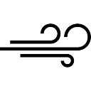
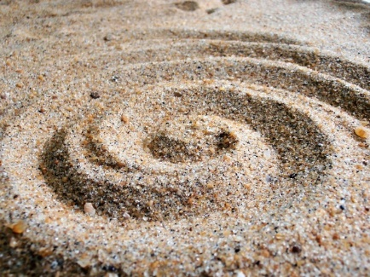
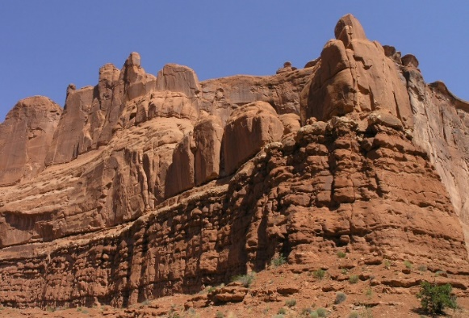
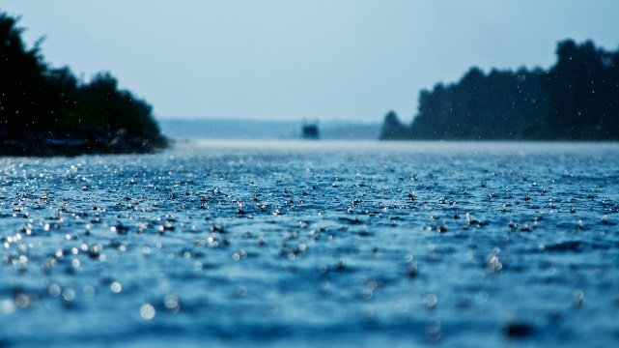
Earth’s Story in Sand and Stone
(by means of water and wind)
Sacramento Area Science Project Institute, Summer 2016
Ingrid Salim, Davis Joint Unified
isalim@djusd.net
Notes:
This lesson sequence addresses the following standards:
4-ESS2-1. Make observations and/or measurements to provide evidence of the effects of weathering or the rate of erosion by water, ice, wind, or vegetation
4-ESS1-1. Identify evidence from patterns in rock formations and fossils in rock layers to support an explanation for changes in a landscape over time.
4-ESS2-2. Analyze and interpret data from maps to describe patterns of Earth’s features.

Slide 2
Creating your own Conceptual Model
For the Teacher:
Below some resources for learning about erosion, weathering and the formation of rock structures as well as the grand canyon. They are meant to provide some background. We invite you to search out resources that are meaningful and helpful to you. We have found that our ability to direct students’ work further really depends on our own model of the phenomenon itself. To that end, it’s good to read about the grand canyon and watch resources that help you create your own mental model. Our best direction comes from the question we pose.
http://nationalgeographic.org/encyclopedia/erosion/
http://www.bobspixels.com/kaibab.org/geology/gc_geol.htm
https://www.nps.gov/grca/learn/nature/geologicformations.htm
Short Version of Grand Canyon
Sciences and Technology
National Geographic
Notes:
There are a number of slides in here that are meant of teacher viewing, not students, and so can be either deleted to form a student version of the presentation, or just hidden. I just skip through them.

Slide 3
Conceptual Progression in Earth Science
Appendix K
 | K-2 | 3-5 | 6-8 | 9-12
ESS2.A Earth materials and systems | Wind and water change the shape of the land. | Four major Earth systems interact. Rainfall helps to shape the land and affects the types of living things found in a region. Water, ice, wind, organisms, and gravity break rocks, soils, and sediments into smaller pieces and move them around. | Energy flows and matter cycles within and among Earth’s systems, including the sun and Earth’s interior as primary energy sources. Plate tectonics is one result of these processes. | Feedback effects exist within and among Earth’s systems.
Notes:
The Conceptual Progression, found in the Appendices on the NGSS website, are extremely useful in understanding why certain ideas are emphasized in specific grade levels. If you, as the instructor, can see how students will build on ideas in later grades, it makes it more clear how to choose phenomena and what ‘making sense’ activities to engage students in at your grade level.
We encourage you to consider these progressions (and to look up the whole sequence and print it out for easy reference) and to reflect on how knowledge of the progressions might inform your teaching.

Slide 4
4-ESS2-1 Performance Expectation
Make observations and/or measurements to provide evidence of the effects of weathering or the rate of erosion by water, ice, wind, or vegetation.
Clarification Statement: Examples of variables to test could include angle of slope in the downhill movement of water, amount of vegetation, speed of wind, relative rate of deposition, cycles of freezing and thawing of water, cycles of heating and cooling, and volume of water flow.
Assessment Boundary: Assessment is limited to a single form of weathering or erosion.
Notes:
This slide is meant for teachers. The highlighted purple part identifies the scientific practice that students will be expected to be using the most for this Performance Expectation. That doesn’t mean that other practices are excluded, but it does mean that if we focus on these emphasized practices over the course of the year, we’ll successfully immerse students in all of them.
The clarification statements can be very useful in that they provide examples of phenomena to use. You are by no means limited to these, but they can help get you started.
The assessment boundary indicates how far the depth of knowledge needs to go for this grade level. That can be helpful to constrain many of us who tend to create units that continue on and on…

Slide 5
Notebook Setup:
What do Wind and Rain do to Planet Earth
Start a new page in your notebook. Create a Title Heading for these lessons.
On that same page, create your own graphic artwork showing what you think this learning might be about.
Notes:
You can either have students use notebooks to document their work, or create handouts for that purpose. Notebooks allow for greater differentiation of responses, but do require more organizational skills on the part of the student. Maintaining a Table of Contents allows students to keep track of what’s in their notebook, as well as use it more efficiently on assessments.
Indeed, to make the notebooks (or handouts) have meanings, students should be allowed to use them on assessments. Some suggested assessment are included in these documents.
This link to the California Academy of Sciences has excellent ideas on how to set up and use science notebooks: http://www.calacademy.org/educators/setting-up-your-science-notebooks.
While I am pretty good at helping them keep a running table of contents, I found that it is helpful to have students check in with each other about titling and starting new pages. There are always students who pick up on these organizational tasks quickly, and those who don’t.

Slide 6
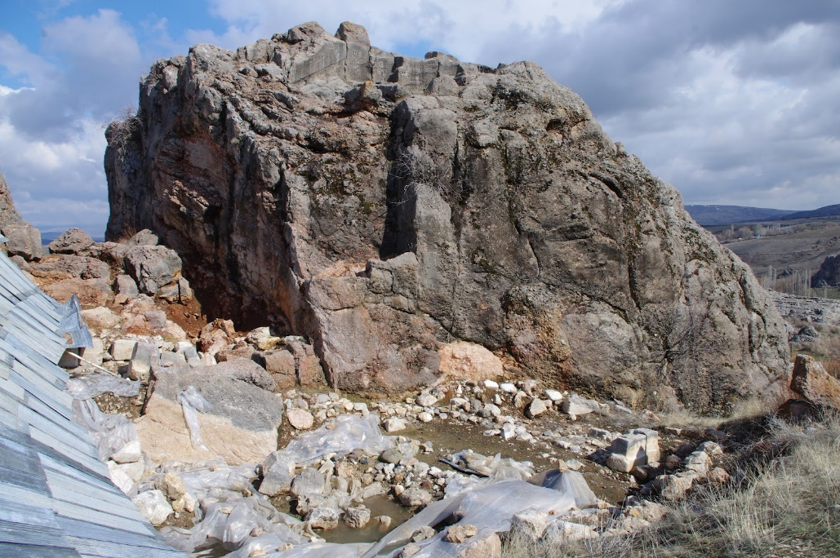
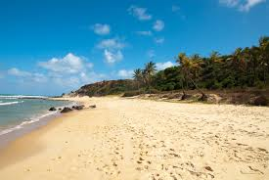
Sandstone → Sand
1. Consider the sandstone on your table.
Consider the images of sand and the rock on this slide. How do you think sandstone might become sand?
2. What are some ways that big rocks might be affected over time?
3. Where do you think does sand comes from, and how does it get to our beaches?
Record your ideas as a group onto a dry erase board, and then into your own notebook when you’re done.
Notes:
For this activity you will need one piece of sandstone per group, which you can buy at any business that sells stone. You also need sand.
Students will readily identify that sand particles come off the sandstone. This is a precursor to the particle model that they will study in-depth in 5th grade, so helping them see this explicitly is an important step in understanding how matter works. As students go on to think about how rocks might change over time, ask them to name elements that affect rocks (wind, rain, blown particles) and then to draw their best idea of what happens and how. This is called an ‘initial model’, or conceptual idea of how a system works.
Although I have students create these models collaboratively on dry erase boards, I do have them recreate them individually in their notebooks. This serves the purpose of allowing them to personalize their models if they have differences with other students; it also gives them a reference point for assessments, and for future models or revisions. Sometimes I will take pics and print out the images, if they are complex enough to warrant that. But that’s an extra step for me so I usually don’t.

Slide 7
Initial Model of How Water and Wind Work
1. Consider the sandstone on your table.
How do you think sandstone might become sand?
2. What are some ways that big rocks might be affected over time?
3. Where do you think sand comes from, and how does it get to our beaches?
Record your ideas as a group onto a dry erase board.
Show WHAT happens, and, as much as possible, WHY or HOW you think it happens.
Everyone should use their own pen to contribute.
Work at having one idea you all agree on, but if you can’t, divide the board up.
Notes:
The idea of modeling is considered an anchoring practice by many and is crucial in the process of helping students make sense of what they see. In making an initial model, based on what they’ve seen and heard in life so far, students process all that background knowledge and show you what they are thinking so that you, as the instructor, can then tailor investigations and prompts to push that thinking. I’m always surprised at the range of background knowledge and that students of all grade levels come in with far more than I usually assume, and are able to reason their way quite quickly to new thinking. As they work together on this sort of prompt, you’ll hear new ways of thinking even before you’ve begun formal investigations.

Slide 8
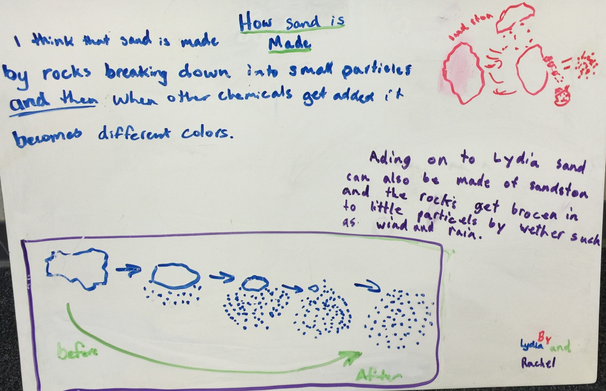
Student Work
Notes:
You may or may not choose to show this to students, or you may want to take images of their work and show them. It can be helpful to demonstrate some ideas of how other students represent ideas to inspire.
Notice the comment, ‘adding on to what Lydia said’ – this board is more like a conversation between students, which it can be helpful to point out as it means they are reading and listening to each others’ work.
Upon completion, these boards are also ripe for a peer review strategy…..see link for those techniques.

Slide 9
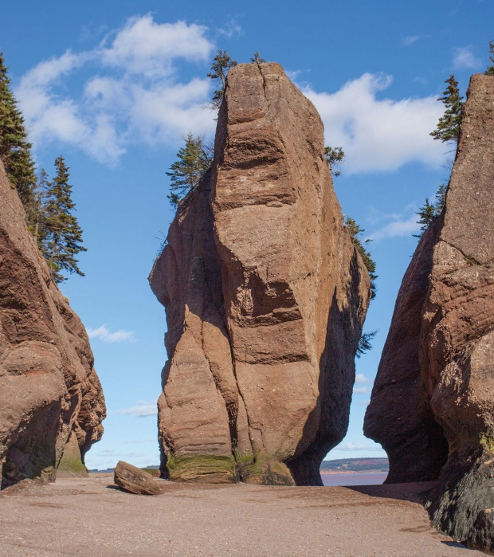
Introducing Phenomena
View slide show twice
  1. The first time to view and enjoy
  2. The second time to record any questions or ‘wonderings’ that you may have.
  rocks - erosion, weathering.....pps
Notes:
This slideshow is powerful, but not editable. All but one of the images are examples of erosion (in case that bothers you). Do let the students just watch the first run, with the music. Then replay with the instruction that they should note questions for one more of the images. Tell them ahead of time that they will be focusing on just one structure to think more about, in case they already want to choose that.
In preparation for the second part, considering one structure, it can be helpful to print out colored images of each slide (a slide show with just those is included with these files). I store them in protective sheets in a notebook, and use them as phenomena across grade levels and topics (particles, weather, spheres…)

Slide 10

Science Practice: Questioning
From the collection you receive, choose one structure to focus on.
On your dry erase board, generate as many questions as you can related to the phenomenon you chose.
How does….
Why does…
I wonder if, whether….
What would happen if…..
Notes:
After students have generated their own questions, divide up the images among the tables and ask them to pick one of the structures as a group to study more closely. I allow them to trade between table groups if they wish.

Slide 11

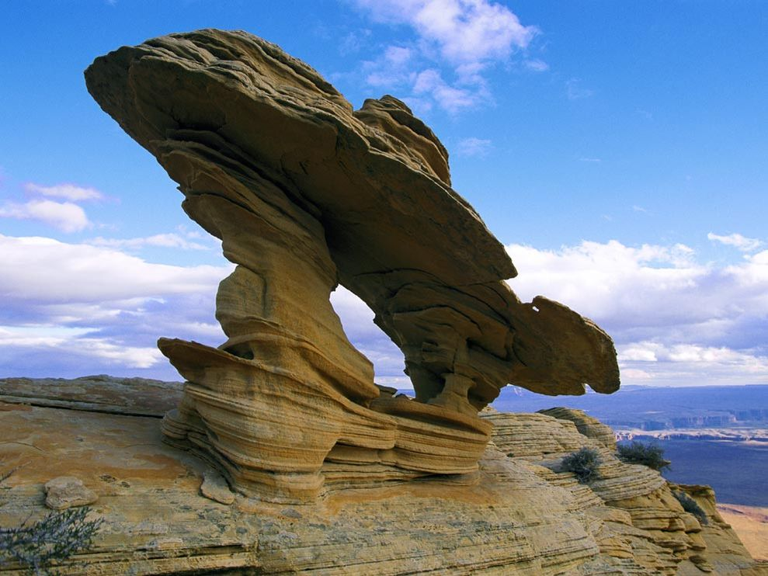
Science Practice: Modeling
1. Choose one how or why question about your rock structure to focus on.
2. On your dry erase board, create a diagram with words that tries to explain your current understanding of how to answer that question.
3. All answers are acceptable, and based on what you know NOW. If your work leads you to more questions, write those down as well.
Notes:
The younger students are more willing to venture into these tasks with less trepidation or insecurity. Walk around the room to see what they are doing. Try not to comment on their work, but do ask clarifying questions if you aren’t clear what they are showing, and probing questions if you think they can take some part of it a bit further. This is again an ‘initial model,’ but it’s also building on the previous smaller model of how particles of sand might brush off larger rocks. As you walk around, even if you hear misuse of terms such as erosion or weathering (and you will!) don’t correct students. Along the way those terms will be clarified and most students will begin using them correctly as you progress.

Slide 12
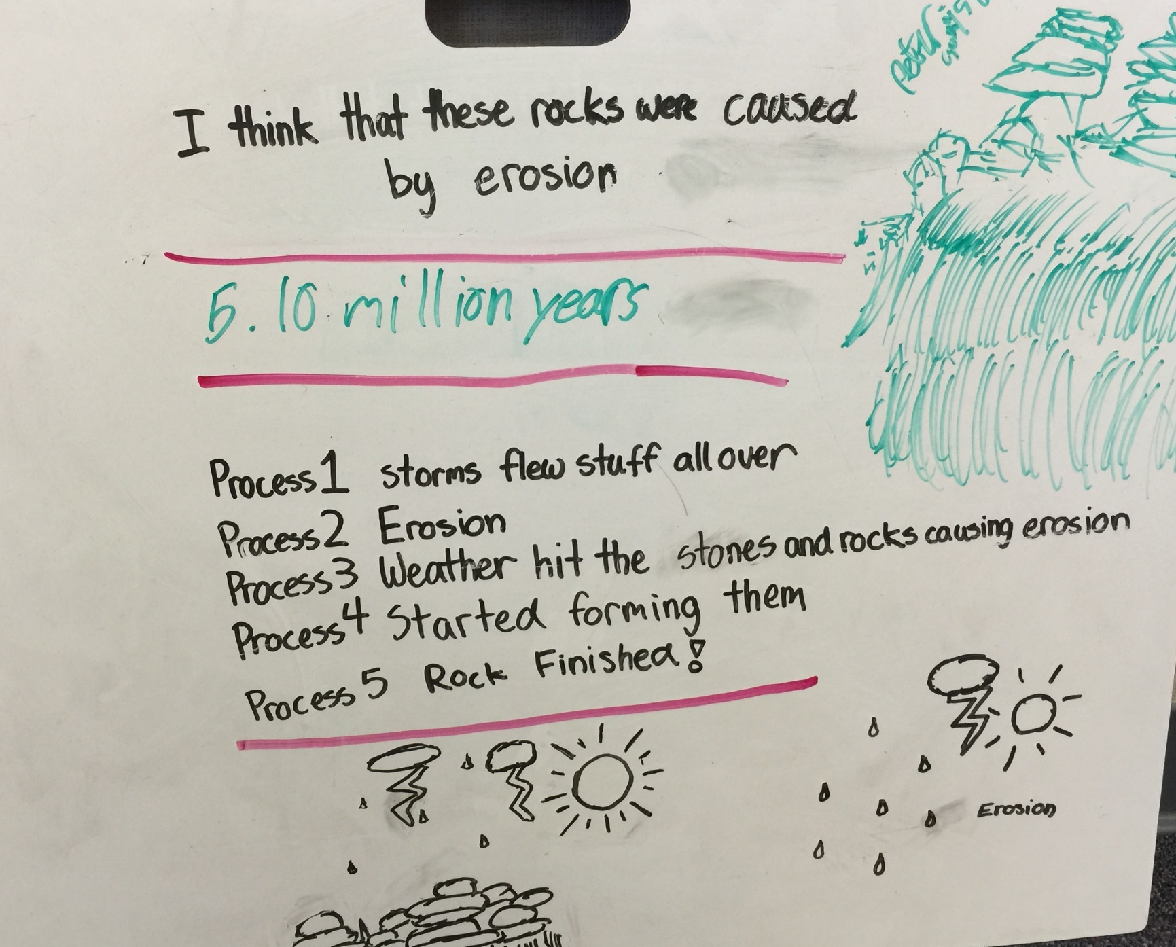
Student Work
Notes:
This example form a 4th grade class if for the teacher, but could be used to be ‘critiqued’ by students. These students were asked also to include any kind of time span, if they could. That question revealed that some had a concept of a long time span (such as this group) but not an accurate ones. Other students had no idea about the scale of time. While the idea of time is a relative one at this grade level, knowing what they do think could help the instructor tailor future lessons to reference those times scales.
The other interesting thing about this group’s explanation is that it is sequential. The human mind naturally thinks in terms of time sequences, so it’s useful to take advantage of that and suggest that students use a sequence when they are working with concepts that do HAVE a sequence.
Finally, from this work I’m not clear that students have any idea how weather can make erosion, or how that might result in the unique shapes they’ve seen, but it’s a great start.

Slide 13

New Phenomenon: Grand Canyon and the Colorado River
Grand Canyon Fly-over from National Geographic
Notes:
So, we started small, with sand and rocks, then went a little bigger, with a number of specific rock structures all over the world. Now we’re watching a short fly-over the Grand Canyon. The idea is that the same physical processes are at work in all of these phenomena, and kids will naturally infer that. From this video and the following images, they will be set up to do some meaningful if simple exploration with sand and water in the stream tables.

Slide 14
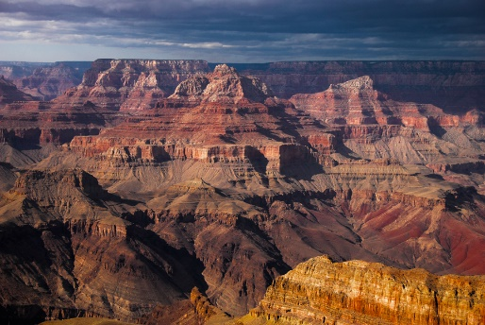
Grand Canyon Journal Observation
In your notebooks, make two columns. Record what you thought about. Do the same for the still images that follow.
observations questions

Slide 15

Notes:
The stills provide more opportunity for observation. You may choose to do these quickly and encourage students to work on their own, or you might open it up for table conversation, or whole class conversation. Students will notice the layers, how wide the canyon is (18 miles at is widest point). You can ask questions as you go such as: why do you think there are layers? Which layers came first, and how do you know (how would you reason that?). Do you think the canyon was made up from the ground this way, or started as a flat space? Why?

Slide 16
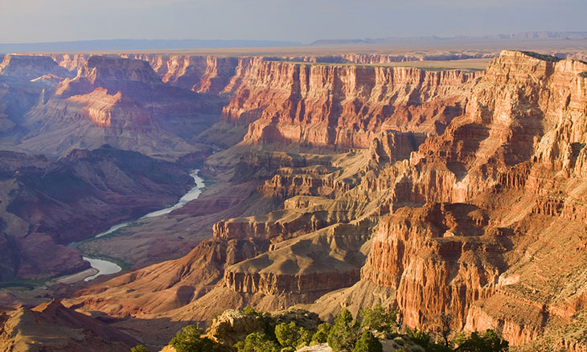
Notes:
Other questions: Where did the river come from? Did it come before or after the canyon?

Slide 17
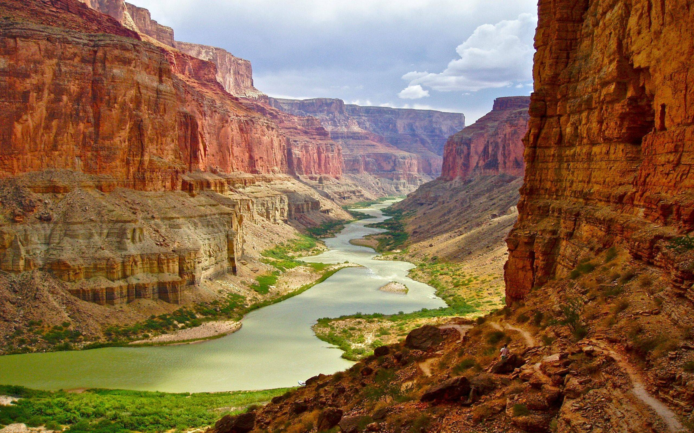
Notes:
Why are there curves in rivers?

Slide 18
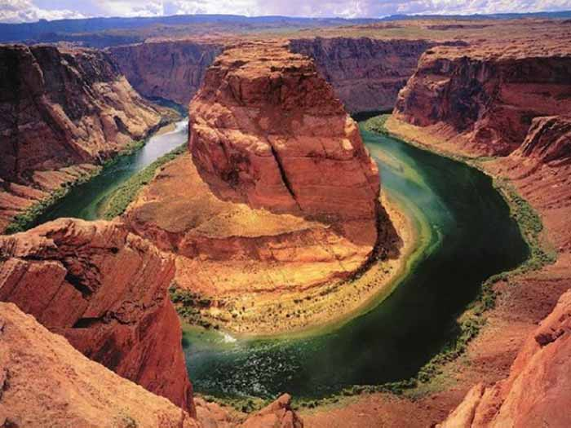
Notes:
Just wow! How could this happen?

Slide 19
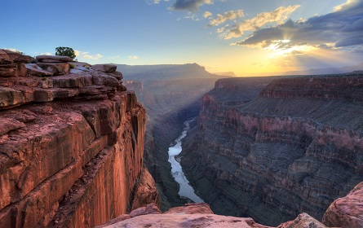

Slide 20
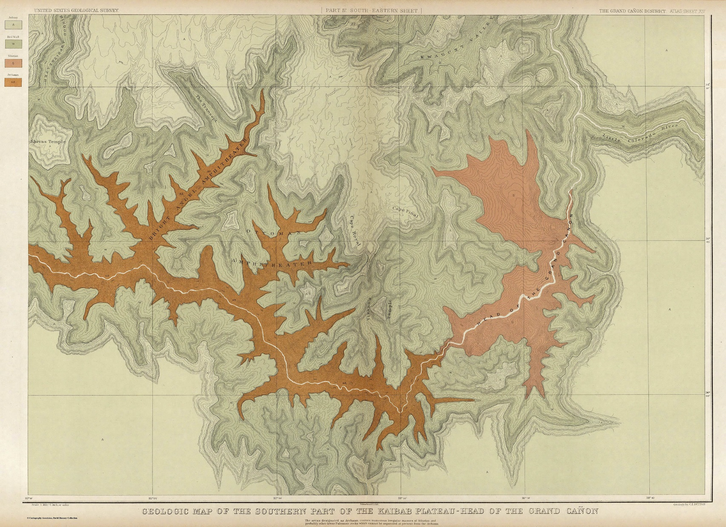
Map of Grand Canyon
Notes:
An early map of the Grand Canyon. What do they see? Draw attention to the main river (Colorado). What are all the things coming off it it? Introduce the word ‘tributary’ , which they’ve probably heard but not put together yet. Depending on your group you can also ask about the pattern of the tributaries….how would they describe that pattern? (It’s a fractal, where each branch extends off at a similar angle and proportional to the larger waterway – very interesting and important pattern in nature and important to mathematics studies.)

Slide 21

Productive Dialogue: Talking Sticks
Protocol: Designate a pencil or other object as a ‘talking stick.’ Take turns discussing the prompt and sharing the stick, making sure that everyone has equal time.
Prompt
Consider the images of the Grand Canyon from the video and the photos.
How did this canyon form?
What role did the river play?
Where did the layers of rock come from and how did they form?
4. What other questions does your group have?
Notes:
This slide can be used or skipped – kids often want to talk about what they’ve seen, and this creates a way for them to do that without it disrupting class. Providing any object as a talking stick makes it a respected activity. Pieces of wood colorfully painted are still my choice.

Slide 22

Notes:
This compilation is to aid students in engaging in the dialogue on the above slide.

Slide 23
Videos of example stream table investigations and questioning
Stream Table
Stream Table - Time Lapse
Notes:
The first video is intended for the teacher – note how the teacher asks many questions provides little explicit direction. This is what we’re after in an inquiry-based, NGSS classroom.
The second video is one I show after these initial investigations by students. It helps them realize both that this kind of time lapse video is a critical tool for science, and allows them to observe more closely. After this, if we have ipads available or they have a phone I allow them to use that app to get better data. Once they know how to use the tool, they tend to do more precise science with it.

Slide 24
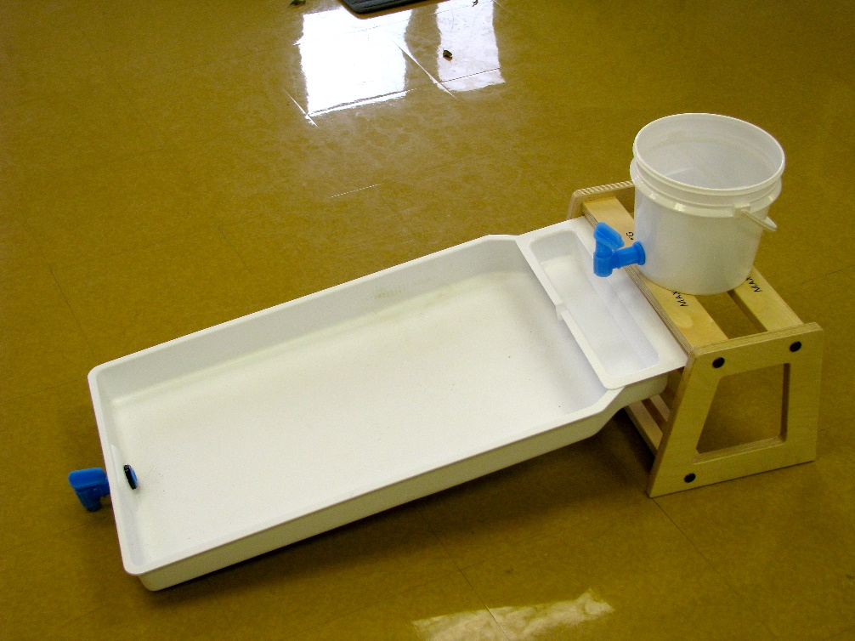
Scientific Practice:
Plan and Carry out an Investigation
1. Make a flat bed of sand
2. Using sand, small rocks and water if you’d like, try to gather evidence for one of these claims:
Rock structures or the grand canyon result from matter being deposited on top of itself
OR
Rocks structures or the grand canyon from matter being taken away, leaving structures behind.
Notes:
The stream table shown here is made by CPO and is fairly durable. They cost $140 each and sold by Frey: https://store.schoolspecialty.com/OA_HTML/ibeCCtpItmDspRte.jsp?item=47286&minisite=10029
You can certainly pull together homemade versions for cheaper, but we’ve found these to be very worthwhile. There’s no other way to study erosion or the effect of water on matter. You can invest in just a few, and create stations in your room as well while students do other activities.
When students first use them, show them the entire set up (as in the image) on a table in the room. You will also need to purchase sand (cheapest at a local rock or lumber or home improvement store) which you fill half way in the trays.
The two prompts on the slide get to the heart of the model: does the structure or canyon arise from nowhere, adding particles on top of particles (additive) or is there flat land first, and some process takes particles away, leaving behind what we see (subtractive). It’s important especially that students who are not clear on this get to experiment, and all are asked to provide evidence for their claim.

Slide 25
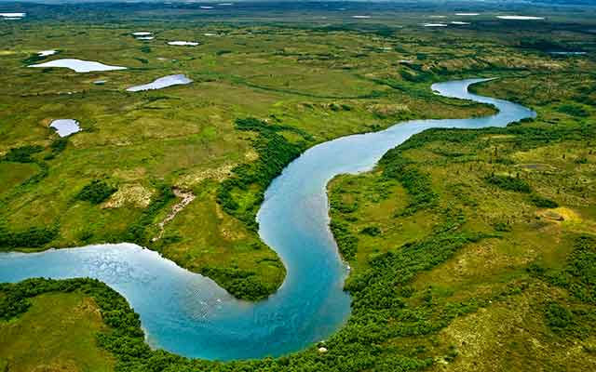
Planning and Carrying Out an Investigation: Creating a River
Use different rates of flow to create a stream or river and watch how matter (both water and sand) moves, and is deposited or eroded.
Plan this investigation ahead (what you will do, what you will control) and draw or write that plan in your notebook.
Record your observations and questions as you go.
Notes:
This part of the investigation can take as long as you feel it is being productive, as there is much to explore. As students realize that the rate of water flow makes a difference in how much matter is carried along, they can simulate the creation of a stream, an out right river, a delta (when matter is carried and deposited at the ‘end’), a flood and can begin to ask question that lead to engineering challenges around levies and dams.

Slide 26

Create your Own Investigation
Design your own question that can be answered by using the stream table. You might consider how flooding occurs and its effect on buildings; or what it takes to block water from flowing, or even how a unique rock structure might form.
Make a plan about how you will answer the question and also set up ways you could track your data.
Carry out your plan and record your data.
Materials available: objects that can represent rocks, houses, buildings
Notes:
This slide can be used separately or in conjunction with other slides. The idea is just to get students designing and carrying out their own investigation. By the time they get to their third or 4th experiment, they should be thinking more explicitly about what they want to try, and so be able to draw or sequence the steps they will take. Keep emphasizing that this is when they go from being a 4th grader playing with sand and water to being a scientists. Indeed, now they are truly engaging in the scientific practices: asking a specific questions and designing their work in such a way that they might gather data to answer it. It is, however, important for students to engage in that play time, as that’s how they become comfortable with the phenomena enough to figure out their questions.

Slide 27
Modeling the Formation of a Canyon River
Using diagrams and words, explain how water changed the landscape in the stream table activities you investigated.
Show what happened to pieces of sand in the river as the water flowed downhill and into the ocean. Tell why it happened.
2. Explain how the river changed over time.
Notes:
When you feel the students have gather enough specific evidence to add to their ideas about how sand, water and wind behave over time, clean up the stream tables and return to the thinking part of these tasks. This model now should go beyond the initial model, showing what happened and why with the grand canyon.
The model held by geologists is of plain thrust up from sea levels over millions of years. It’s built up of layers or rock holding fossils that tell us about the time period of each of those layers. The top, or youngest of all those layers is about 250,000 yrs old and used to be an ocean. The very oldest layer, at the bottom, is about 1.25 million years old and was also coastal. Many complex tectonic processes combined to elevate the Colorado Plateau to its current position, although the very top layers have been eroded off. Water pooling at the lowest place began to carve out the canyon after the Rocky Mountains formed, about 60-70 million years ago. Water trickling down the mountains found the path of least resistance, and slowly wore down particles of those rock layers, moving back and forth and carving out an entire canyon.
You’ll find the results of your students amazing, although there might still be the occasional misconception still. Try to find constructive question to ask those groups to lead them to more evidence-based claims. Questions might include: you’re showing that layers added onto each other. What evidence do you have that they would layer on top of each other exactly the same here, and there, but not in the middle? Can you think of a real-example where that would happen?

Slide 28
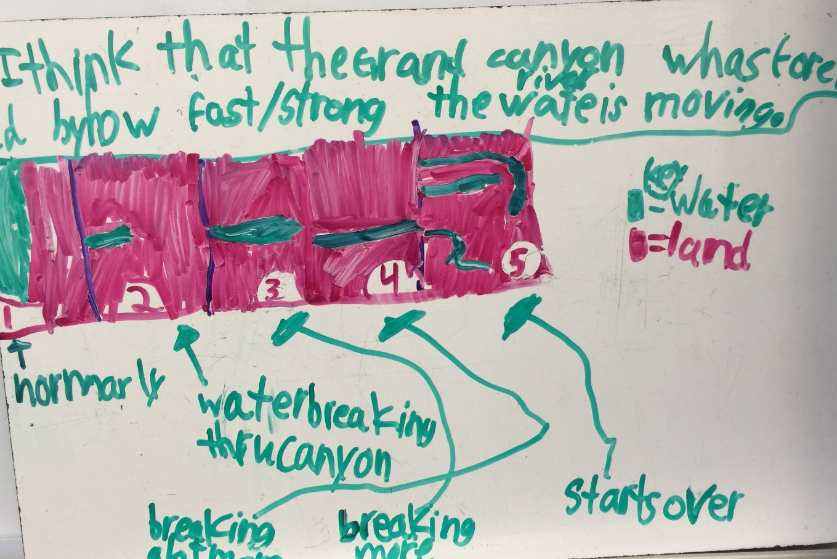
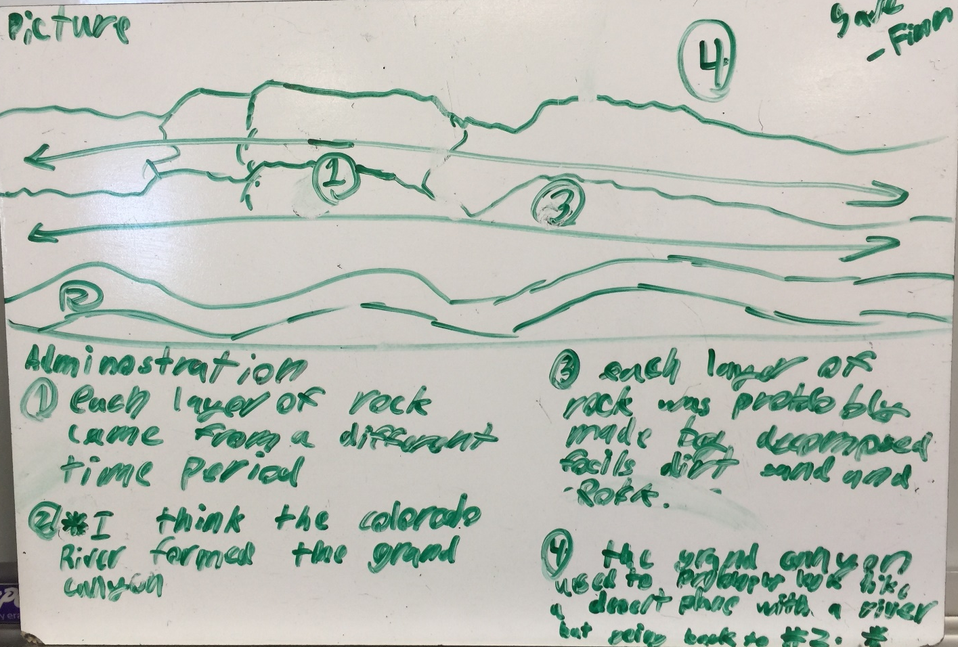
Modeling the Grand Canyon
Notes:
Some examples form 4th grade on this slide and the next. These were some of the first models I collected on this topic, and I can see that there are many places to go with them, in terms of asking questions about time, force, moving particles etc. Note that of the four shown, there is some sequence to all of them, but that they very in abstract-ness. I think in this case I would provide the Scientist’s Review (calling myself the scientist) to provide questions for each group to think about, as they would be different.
Questions like, where did the water even come from; how did the water ‘make’ the layers (I don’t think that’s what the group means); where did the layers come from? How did they get here? How long do you think it took for the river to carve out the canyon, and why do you think that? Where did all that stuff that was IN the canyon go? Can you find it?

Slide 29
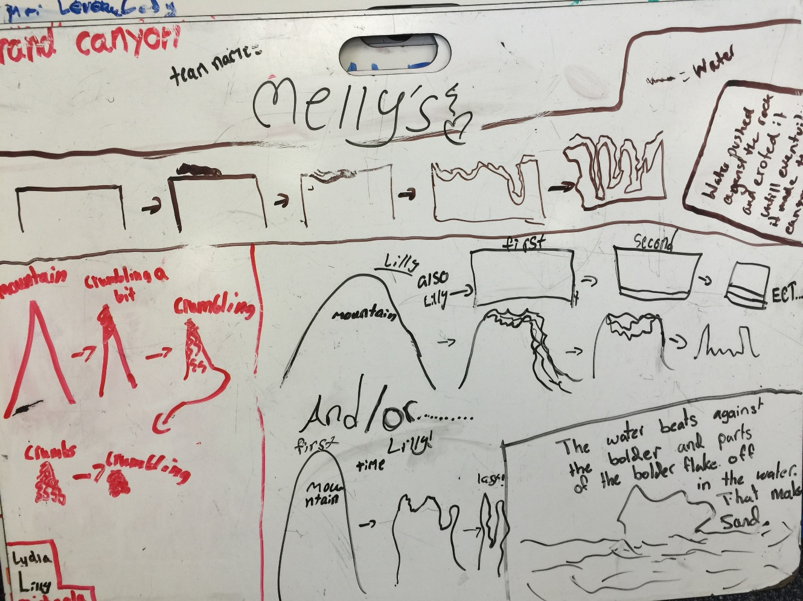
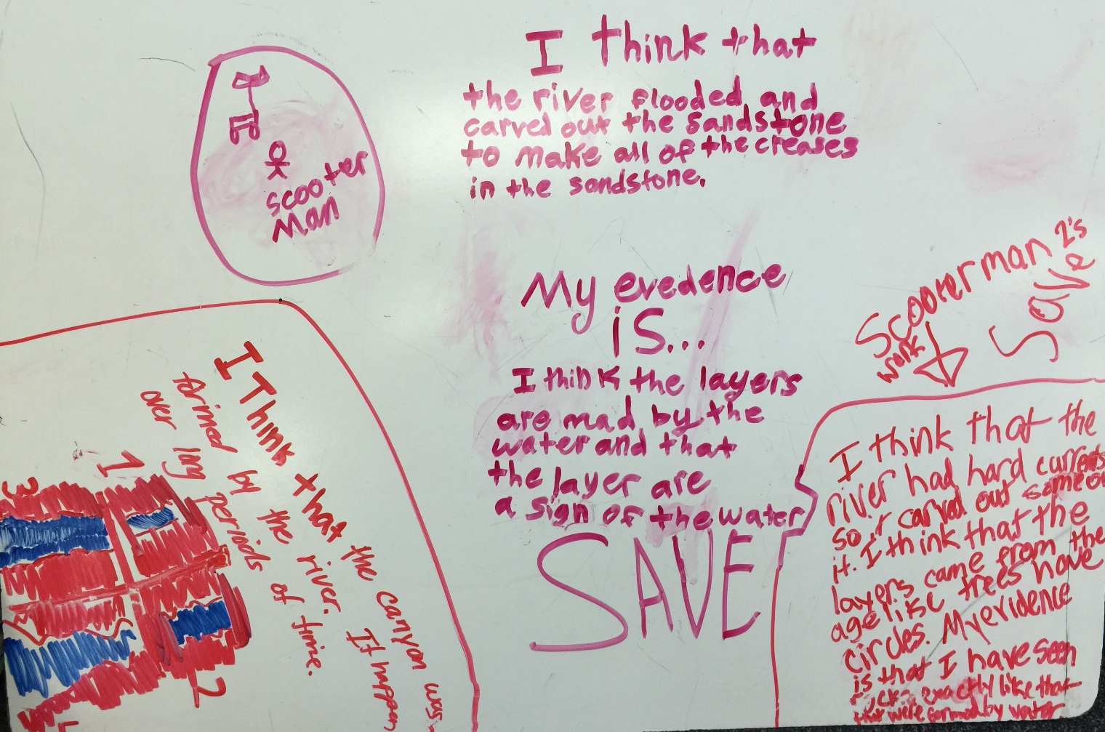
More…

Slide 30
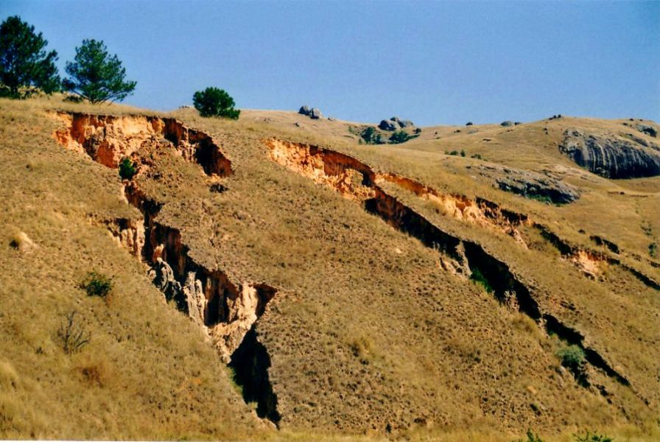
Reading about Science
Read the piece on Erosion
Work alone or with a partner to
complete the reading guide.
Notes:
I adapted a piece on erosion from ReadWorks. I find that to be a good source for beginning pieces, but do edit and add material that fits the NGSS we’ve done as well as vocabulary. I vary the way that students read, always allowing for individual reading (the most independent kind) but often creating other options as well – pair/share reading, small group, etc.
I also vary the processing of that reading, using vocabulary identification (this is often the first time they’ve seen words formally introduced, although I’ve used them orally throughout and in writing). I use dialogue as well as open-ended writing to help students make meaning of text.

Slide 31
Science words we should know
natural event
process
erosion
deposition
sediment
canyon
tributary
delta
Teaching Science is Teaching Reading
Notes:
As part of the reading guide they’re asked to identify words. These are the words in the text that might have been new, so I want to make sure all students have them. I have them add the last two, although they don’t appear in the text. We’ve been using them and they are integral to a discussion on rivers and canyons and moving water.

Slide 32
Two Assessments – for teachers
CER
The CER is a structured way for students to provide evidence for a claim. This shows their engagement in the practice of arguing from evidence and allows them to showcase their reasoning.
Open-ended Modeling
After completing the CER, my more sophisticate students felt it had been too easy. In the interest of wanting to differentiate assessment more, and provide an opportunity for all students to stretch their wings a bit, I expanding the assessment.

Slide 33
Productive Dialogue: CER
Consider what you discovered as you investigated your question, and what you found out about how water and sand interact over time.
Make a list of claims you would make about these interactions, the evidence that supports them and how you would use reasoning to connect the two. For example, one might be.
Claim Evidence Reasoning
Water pushes sand When we let the water Sand pieces are small in front of it. move fast into the sand, and are easily carried the sand was washed by the force of water away.
Notes:
As preparation for the CER assessment, students completed this in groups. I showed them the example, and provided the template. They then chose another claim and practiced providing evidence and reasoning. I used a Peer Review on this as an Exchange. Because it was structured enough, students were able to weigh in on whether each other’s evidence and reasoning were convincing. If not, they had to say why not and the first group had a chance to revise.

Slide 34
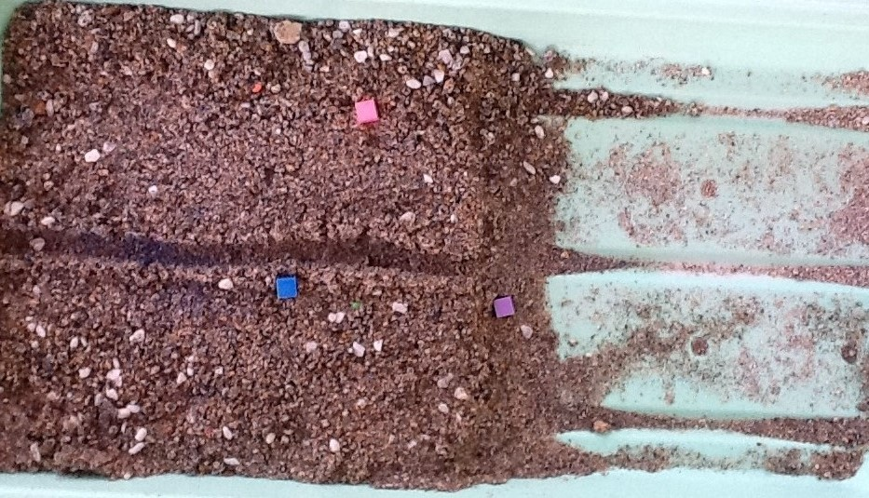
Assessment: Making a Claim
There are 3 ‘houses’ in the land depicted above. The channel in the middle becomes a river after rain. Use your understanding developed during this unit to make a claim about each of those houses. Provide your evidence, based on the investigations you did and recorded in your notebook, and your reasoning about that evidence.
Notes:
There are three parts to these assessments. You can mix and match, give them all, or create new ones. To some extent these go beyond the Performance Expectation as they ask students to apply a model, not just make observations to provide evidence, although they are asked to do that. From our perspective, students make meaning out of what they observe when they begin to form mental models that they can then represent. In many ways, this is where differentiation lies in that it allows for the full range of student expression.
To emphasize the need for keeping an organized notebook, I allow and expect students to use their notebook on every assessment or project. As students catch on that this practice can be helpful, there is a slow but steady increase in notebook use as well as more attention paid to organizing it. This connection is the best incentive I’ve yet found.
The provided rubrics are outlines. If you wish to put less emphasis on the modeling, you can treat those questions as open-ended and only assess the use of evidence and reasoning.
Finally, another strategy for assessments like these is to show the students the questions and give them time to dialogue in their groups before writing their own individual responses. Assessment For Learning, where students deepen their understanding of the ideas even as they are assessed was first promoted by Rick Stiggins. I usually opt for this kind of an approach, and see that it does deepen meaning for students, allows for the best performances from everyone and increases the bonds they have with their peers.

Slide 35
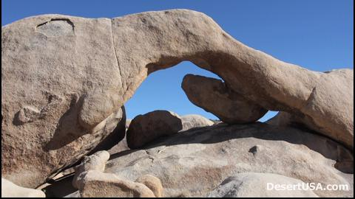
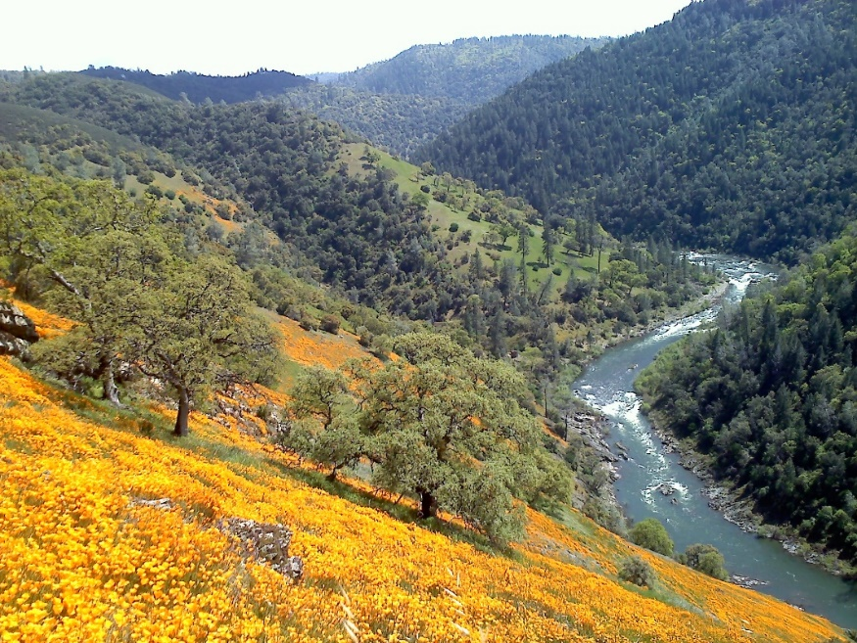
Assessment: Representing your Model
Observe the Joshua Tree Rock Feature or the American River Canyon. Using diagrams and words, explain how you think ONE of these structures was formed.
In your writing, make a claim, and then back it up with evidence from your investigations, our class discussion, your group models and your claims/evidence writing. Include in your discussion references to WHAT happens, WHY it happens and an idea of how much TIME might be involved.
Notes:
I used these two phenomena as they are in our state, California, and the canyon is only an hour drive. You may want to use phenomena from your region for a deeper engagement.

Slide 36
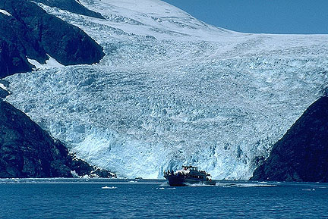
Assessment: Applying your Model
A glacier is a layer of ice that doesn’t melt from year to year, but does move, as individual particles at the bottom layer slowly slide. Use your model to explain what you think will happen to the rock beneath this glacier as it slowly moves towards this sea. Use diagrams and words in your response, and be sure to make your thinking visible as best you can.
Cite any evidence that will support your argument, and provide your reasoning as well.
Notes:
If you live near a place that has glaciers, I would use an image closer to home. While we have many glaciated rocks in our Sierras, I opted for students predicting how the model would apply, rather than showing rock and having them explain how it got to be smooth or why it has pits. Both are valid approaches. Note, too that we did not do much with wind, but you certainly could, or could ask an application assessment question using wind as the source of weathering, such as waves on sand.

Slide 37
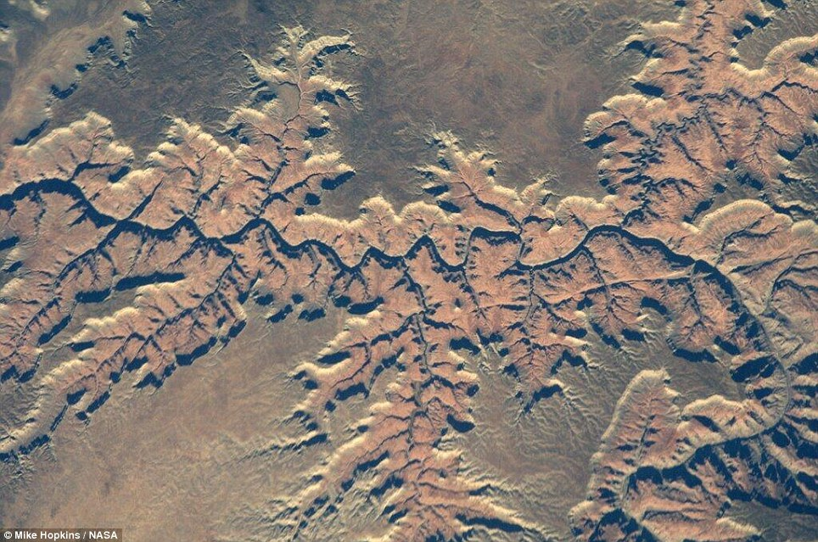
Grand Canyon Satellite Image
Notes:
To end this unit and move on to rock strata, I want to tie in this image to bigger questions about why geologists might connect with planetary scientists on these questions. Here is another image of the grand canyon, and I ask students to study it and then compare it with the next image and predict where it is.

Slide 38
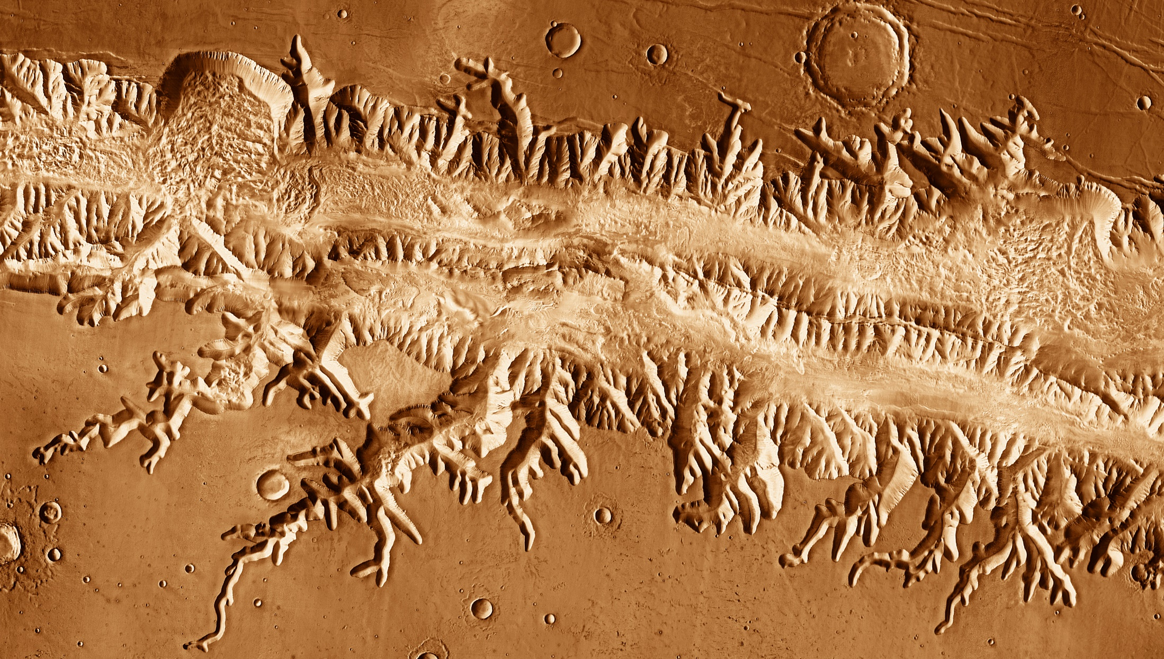
Valles Marinares, Mars
Notes:
This image is a satellite image from Mars, but closely resemble river system on Earth. There is no flowing water on Mars right now, that we know of, but here is another clue that rivers once ran there. When younger students see this image (unlike high school students or adults) they do not readily recognize that it is another planet, and are flabbergasted to learn that it is Mars.).
The big idea is that everything we learn about things work on Earth informs how we make sense of phenomena that is extraterrestrial. This is an opportunity to highlight careers that involve people in these questions.

Slide 39
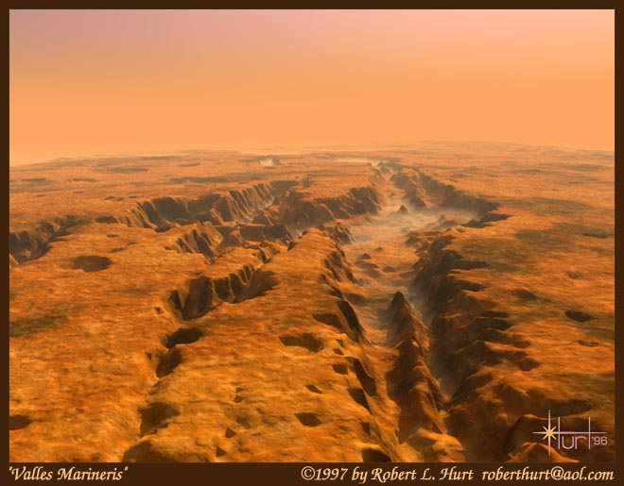
Notes:
And finally, this is a science-informed imaging by a respected ‘space artist’ , using the satellite imagery and knowledge of how canyons work here on Earth. Again, someone makes aliving doing space art for NASA!

Slide 40
Connecting Back to NGSS
Science is all about making sense of something, figuring it out….can be done in a variety of ways
Engaging Phenomena, doesn’t always have to be ‘hands-on’.
Kids WANT to construct meaning – our brains are wired for it
Differentiation – give enough so that everyone can go as far and as deep as possible – can’t just be more of the same
This lesson foreshadows the particle model in 5th grade, and weather and climate in 6th, and it builds on awareness of wind and water from 3rd
Communication tools and strategies are essential: talking, writing, recording, presenting – all help build confidence in learners
Notes:
For teachers: general connections to NGSS

